Slide 1



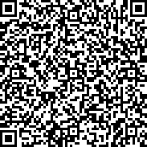


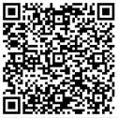
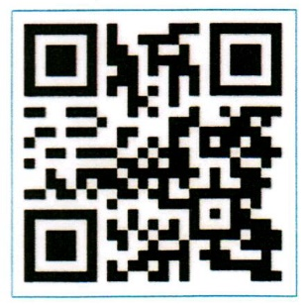

All Inclusive
Your feedback is important to us – please share your experience with us on
Menu
Mini guide
Scan the QR
code to view
Restaurants, Bars &
Facilities’ timings

Slide 2

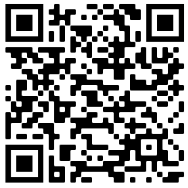
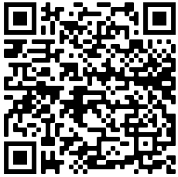





All Inclusive Standard Beverages
Dear Guest,
Welcome to Fujairah Rotana Resort & Spa
Please find herewith relevant information about your meal package as well as a brief resort orientation.
Should you require any further assistance, please dial ‘0’ for Guest Services.
We wish you a relaxing stay with us.
Sincerely,
Hotel Management
All Inclusive Package
Includes buffet breakfast, lunch and dinner in Mozaique.
Ice-cream in Sharkeys once per day for kids below 12 years old from 4:00 Pm to 5:00 Pm
The all-inclusive package starts on the day of arrival at 15:00hrs and ends on the departure day at 12:00 noon.
All Inclusive alcoholic beverages will be served from 10:00 Am till 10:00 Pm in our outlets.
Sharkeys:
All-inclusive drinks are served from 12:00 Pm to 10:00 Pm
AED 60 credit per day, per adult can be used against your food bill instead of your lunch & dinner at Mozaique restaurant.
Kids below 12 years old dine for free from the kid's menu, while dinning with their parents
Tropicana:
All-inclusive drinks are served from 10:00 Am to 7:00 Pm
AED 60 credit per day, per adult can be used against your food bill instead of your lunch at Mozaique restaurant.
Kids below 12 years old dine for free from the kid's menu, while dinning with their parents.
BarMuda:
All-inclusive drinks are served from 06:00 Pm to 10:00 Pm
Guests are entitled for 30% discount on the Food bill (excluding Tobacco and special promotions)
Waves:
All-inclusive drinks are served from 06:30 Pm to 10:00 Pm
Guests are entitled for 30% discount on the food bill (excluding Tobacco and special promotions)
Kids below 12 years old dine for free from the kid's menu, while dinning with their parents.
Outlets not included:
Room Service and Al Falaj Lobby Café.
Additional Benefits:
Add AED 180 per person, per night and upgrade your package to “Dine Around”
Enjoy 50% discount on All-inclusive beverages from 10:00 Pm onwards in all participating outlets
Non-alcoholic Beverages
Water:
Local mineral still water (small / large)
Chilled juices & soft drinks:
All soft drinks & Canned juices
Hot beverages:
All kinds of coffee & tea (including Ice tea/Coffee)
Alcoholic Beverages
House wine:
Red wine, white wine & Rose
Beers:
Becks & löwenbräu
Pouring brand spirits:
Gin, tequila, whiskey, rum (white/dark), vodka & brandy
Mocktails:
Cinderella, lemon squash, apple tree, shirley temple
Cocktails:
Sea breeze, cosmopolitan, tequila sunrise, whiskey sour, cuba libre, sidecar, toronha, caipirinha, pink lady, brandy sour
Download our mobile App by scanning the below QR codes
iOS Android
Additional Information
Follow us on Social Media @fujairahrotana
For your safety and hygienic reasons, outside
food, shisha, kid’s roller board (Segway),
scooter & bicycle are strictly not permitted
in all resort premises

