Slide 1



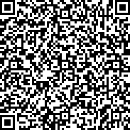


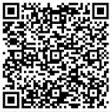
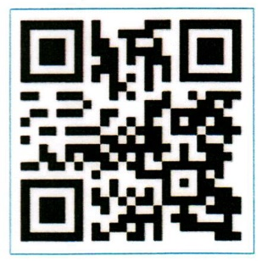

Dine Around
Your feedback is important to us – please share your experience with us on
Menu
Mini guide
Scan the QR
code to view
Restaurants, Bars &
Facilities’ timings

Slide 2

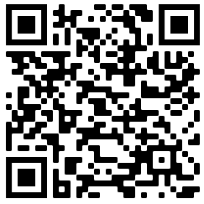
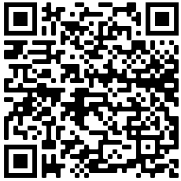





Dear Guest,
Welcome to Fujairah Rotana Resort & Spa
Please find herewith relevant information about your meal package as well as a brief resort orientation.
Should you require any further assistance, please dial ‘0’ for Guest Services.
We wish you a relaxing stay with us.
Sincerely,
Hotel Management
Dine Around package
Additional benefits
Dine Around the hotel outlets and enjoy limitless joy at our included restaurants and bars.
The Dine Around package starts on the day of arrival at 15:00hrs and ends on the departure day at 12:00 noon.
Premium alcoholic beverages will be served per glass from 10:00hrs – 22:00hrs in our outlets.
Mozaique All day dining:
Premium drinks are served from 12:30 Pm to 10:00 Pm
Breakfast, Lunch & Dinner - Open Buffet
Sharkeys:
Premium drinks are served from 12:00 Pm to 10:00 Pm
Lunch & Dinner - Three course set menu instead of your Lunch & Dinner at Mozaique restaurant.
Ice-cream once per day for kids below 12 years old from 4:00 Pm to 5:00 Pm
BarMuda:
Premium drinks are served from 06:00 Pm to 10:00 Pm
Lunch & Dinner - Three course set menu instead of your Lunch & Dinner at Mozaique restaurant.
Waves:
Premium drinks are served from 06:30 Pm to 10:00 Pm
Dinner - Three course set menu instead of your Dinner at Mozaique restaurant.
Tropicana:
Premium alcoholic beverages are served from 10:00 Am to 07:00 Pm
Lunch - Three course set menu instead of your Lunch at Mozaique restaurant.
Kids below 12 years old dine for free from the kid's menu, while dinning with their parents at Sharkey`s, Waves and Tropicana
Outlets not included: Room Service.
Additional activities:
One pastry item or two big scoops of ice cream per day at Al Falaj.
30% discount on Spa Treatments & Products
50% discount on Laundry services
Water sport activities 15% discount on motorized activities and 20% discount on non-motorized activities
Enjoy 50% discount on Premium beverages from 10:00 Pm onwards in all participating outlets
Premium Alcoholic Beverages:
Whiskey
J.W. Red Label, Jack Daniels, Jim Beam
Gin
Gordon’s ,Tanqueray, Bombay Sapphire
White Rum - Bacardi
Dark Rum - Captain Morgan Spice Rum
Tequila - Jose Cuervo, Tenampa
Brandy – Three Barrels
Aperitif – Rosso, Bianco, Dry
Vodka - Absolute BLUE
Red Wine
Terre Allergen Sangiovese, Italy
Da Luca Primitivo, Italy
White Wine
Hardy’s Riddle Chardonnay, Australia
Vistana Sauvignon Blanc, Chile
Rose Wine
Berri Estatae Rose, Australia
Beers
Löwenbräu, Budweiser, Corona, Beck’s
Draught Beer - Budweiser, Löwenbräu
Selection of Cocktails
Pina Colada, Margarita, Mojito, Sangria, Bloody Mary, Cosmopolitan Tequila Sunrise, Whisky Sour, Caipirinha, Brandy Sour
Selection of Mocktails Cinderella, Lemon Squash, Apple Tree, Shirley Temple
Download our mobile App by scanning the below QR codes
iOS Android
Follow us on Social Media @fujairahrotana
Non-alcoholic Beverages
Water
Local mineral water (Still / Sparkling)
Chilled juices & soft drinks
All soft drinks & conserved juices
Hot beverages
All kinds of Coffee & Tea

