Slide 1
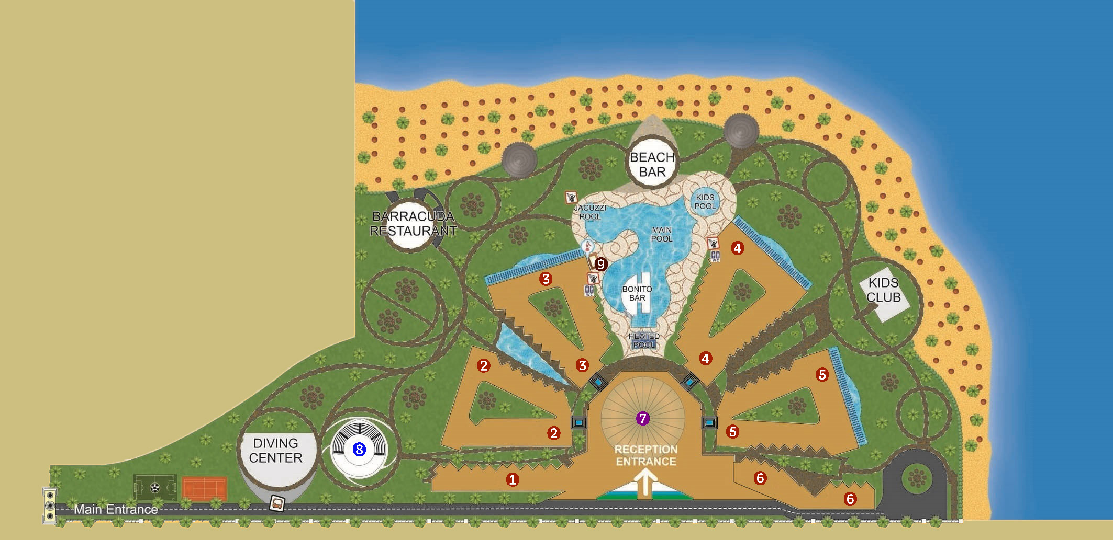













HOTEL MAP
Building 1
Amphitheater
Clinic
Oil Shop
Beauty Salon
Building 2
Building 3
Building 4
Animation team
Building 5
Towel center
Building 6
Main Building:
LA BRISA Restaurant
RECEPTION
BARRIO Lobby Bar
Shops
BUENA VISTA Bar
BYBLOS Restaurant
SPA

