Slide 1
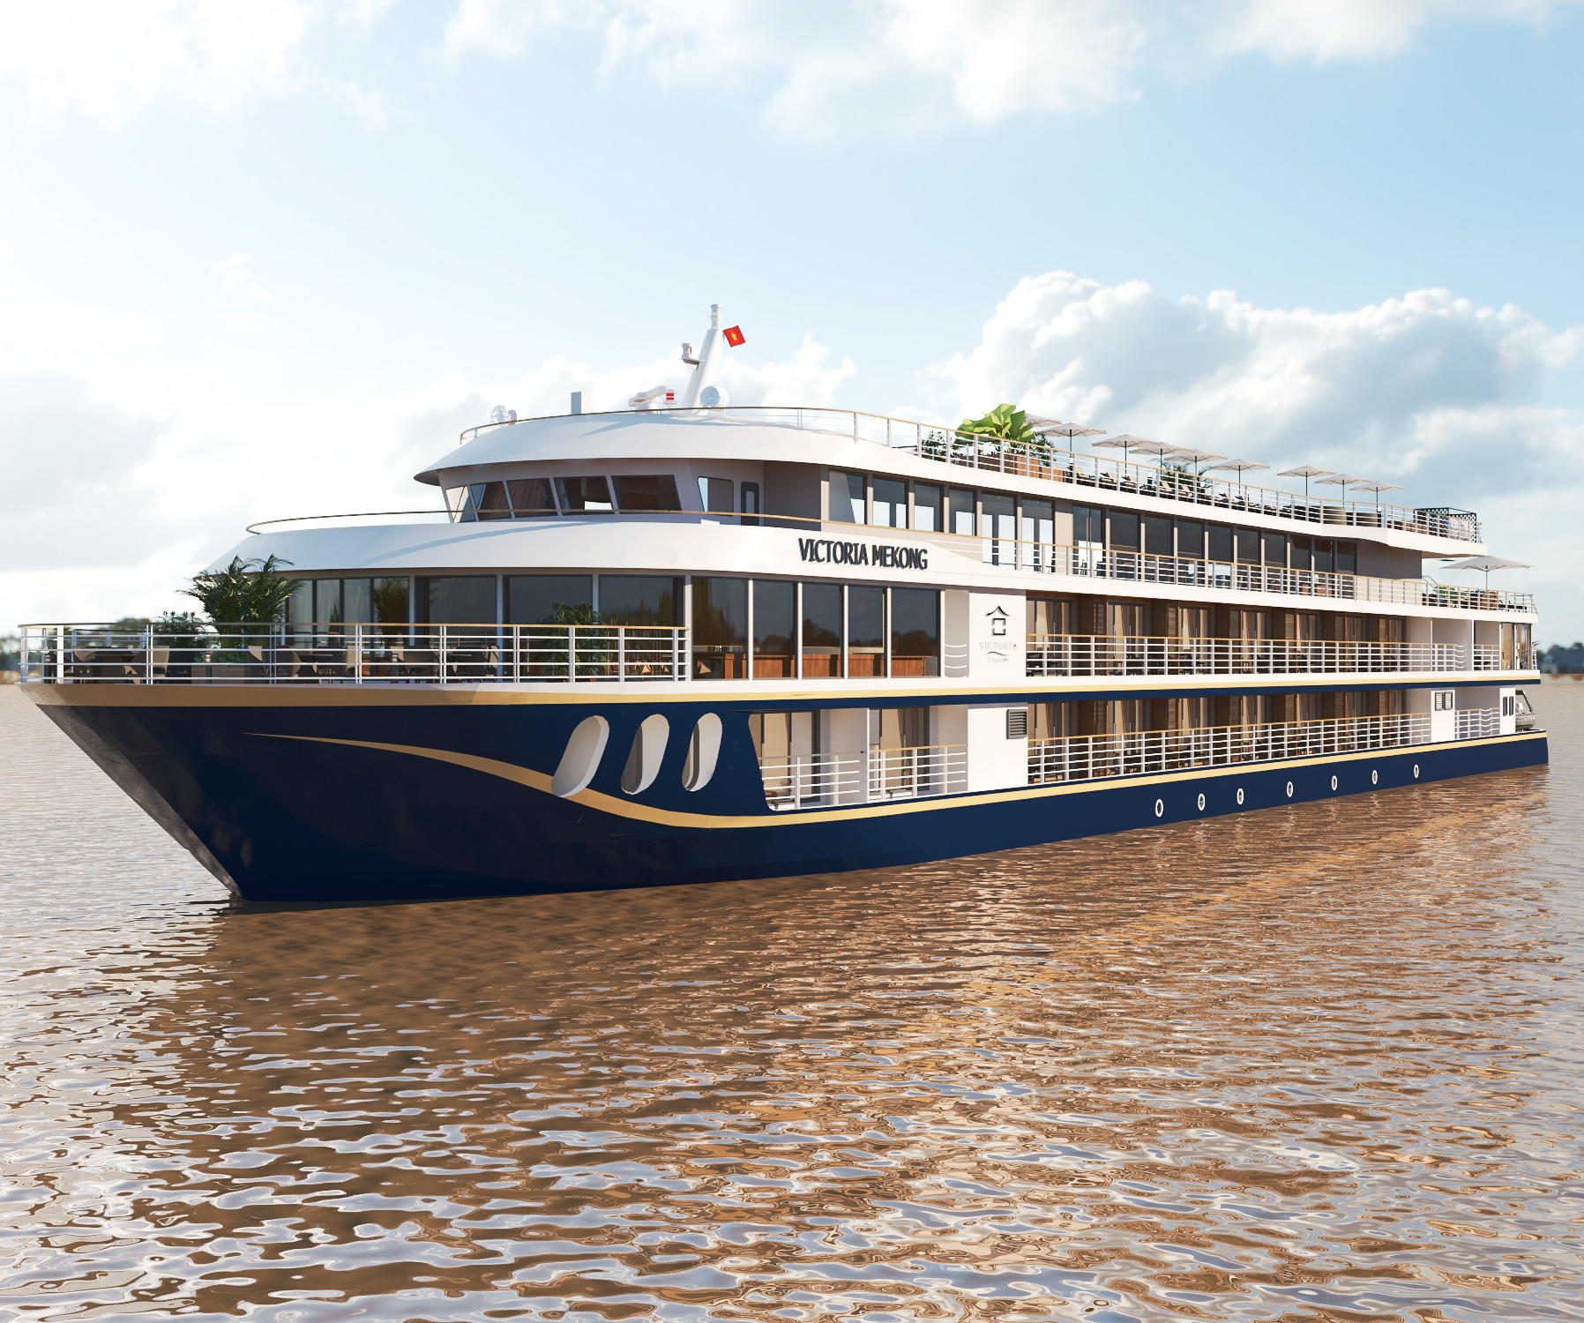
Victoria Mekong
F&B Menu Concept

Slide 2
UPSTREAM - VIETNAM TO CAMBODIA 5D/4N
Day | Daily Theme | Setup | Breakfast | Lunch | Cocktail | Dinner
1 | Mekong Delta theme | Traditional music / table setup | N/A | Mekong lunch buffet with live station | Mekong Delta street food | Vietnamese set menu with Live cooking
2 | European theme | European music / table setup | Multi cuisine buffet breakfast | Western Lunch buffet with Live station | Western savory and sweet snacks | Western set menu with Live cooking
3 | Oriental theme | East Asian music / table setup | Multi cuisine buffet breakfast | Lunch buffet with Khmer, Chinese and Thai cuisine with Live station | Khmer, Chinese and Thai cuisine savory and sweet snacks | Cambodian set menu with Live cooking
4 | International theme | English, West Asian, Vietnamese music / table setup | Multi cuisine buffet breakfast | Mediterranean, Italian and West Asian cuisine with Live station | Mediterranean, West Asian and Western savory and sweet snacks | Dinner buffet - International cuisine Live cooking
5 |  |  | Multi cuisine buffet breakfast | N/A | N/A | N/A

Slide 3
DOWNSTREAM – CAMBODIA TO VIETNAM 4D/3N
Day | Daily Theme | Setup | Breakfast | Lunch | Cocktail | Dinner
1 | Mekong Delta theme | Traditional music / table setup | N/A | Mekong lunch buffet with live station | Mekong Delta street food | Vietnamese set menu with Live cooking
3 | Oriental theme | East Asian music / table setup | Multi cuisine buffet breakfast | Lunch buffet with Khmer, Chinese and Thai cuisine with Live station | Khmer, Chinese and Thai cuisine savory and sweet snacks | Cambodian set menu with Live cooking
4 | International theme | English, West Asian, Vietnamese music / table setup | Multi cuisine buffet breakfast | Mediterranean, Italian and West Asian cuisine with Live station | Mediterranean, West Asian and Western savory and sweet snacks | Dinner buffet - International cuisine Live cooking
5 |  |  | Multi cuisine buffet breakfast | N/A | N/A | N/A

